Slide 1

UNIBUDDY

Slide 2
Akshay Parab Kaushik Gnanasekar Shivam thabe swini rodrigues
unibuddy

Slide 3

Project description
UniBuddy solves most problems faced by international university students like networking, finding roommates and staying up to date with the latest trends.
UniBuddy has been built by students who have faced similar obstacles and aim to solve them by offering a secure and credible web application.

Slide 4

Tech stack
Node.js
Express
React
Material UI
Redux
SMTP Mail Service
MongoDB
Socket.io
JWT Auth
TOTP Based Verification
Docker
Session Management

Slide 5
Features
Application:
Roommate Finder: Intuitive networking platform to find the perfect roommates by matching personalized preferences
Blogs: Publish and access blogs written by verified university students to stay updated with the latest trends
Authentication:
JWT Token (RSA256) based with short lived access tokens and long-lived refresh tokens. API calls and Websocket connections secured and verified using JWT
Credibility:
Verified university email-based registration
Secure:
Passwords encrypted using Bcrypt. Forgot password done through TOTP based verification

Slide 6
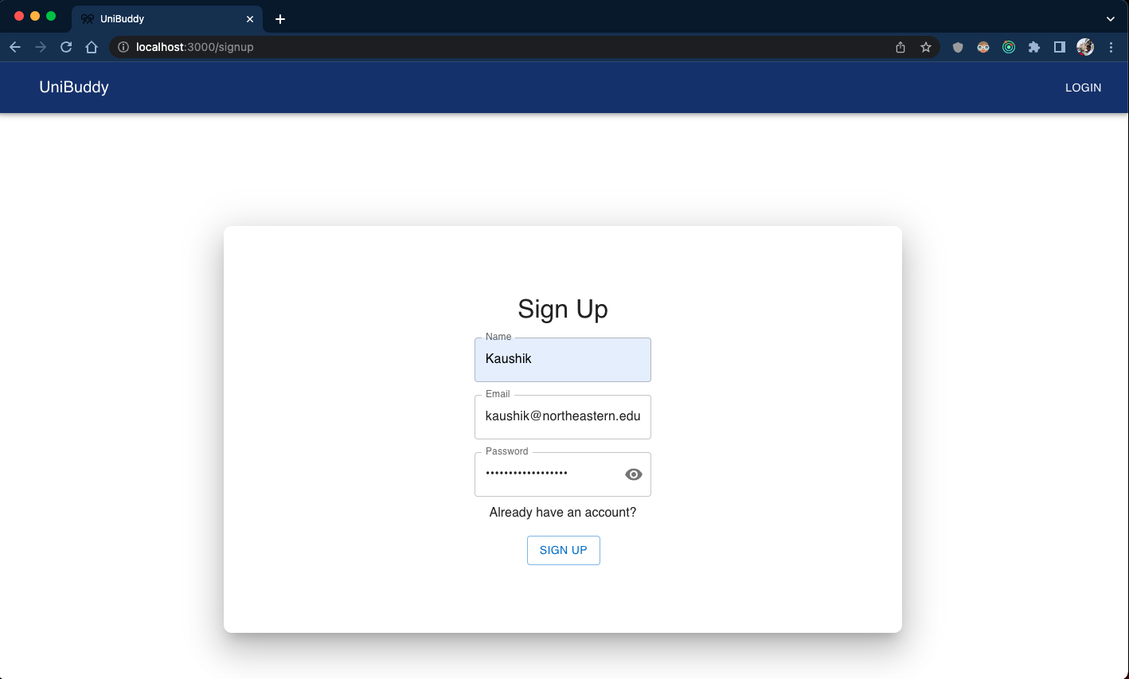

Slide 7
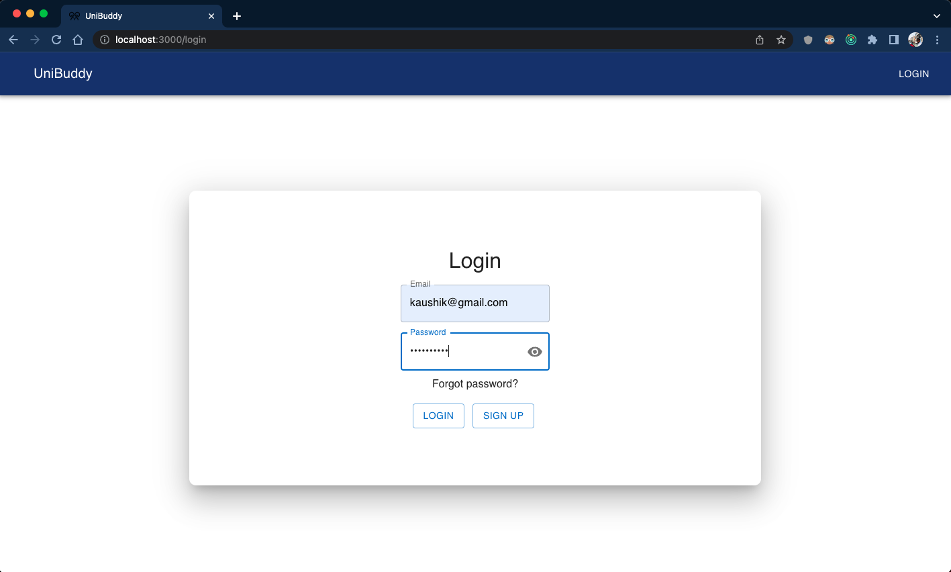

Slide 8
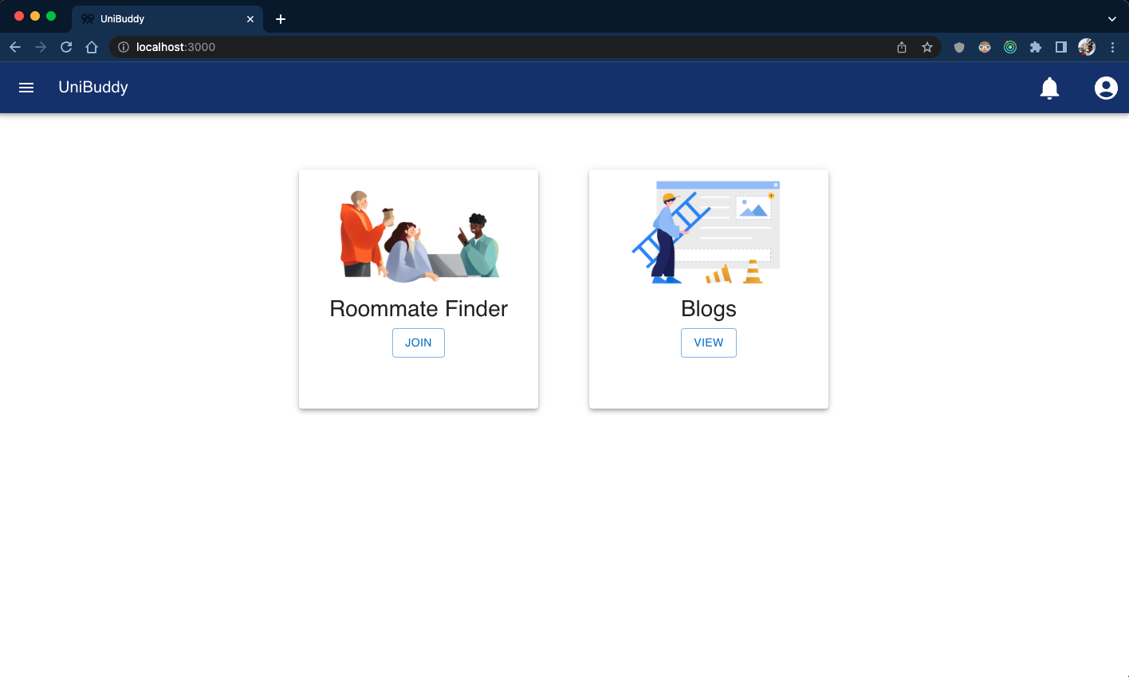

Slide 9
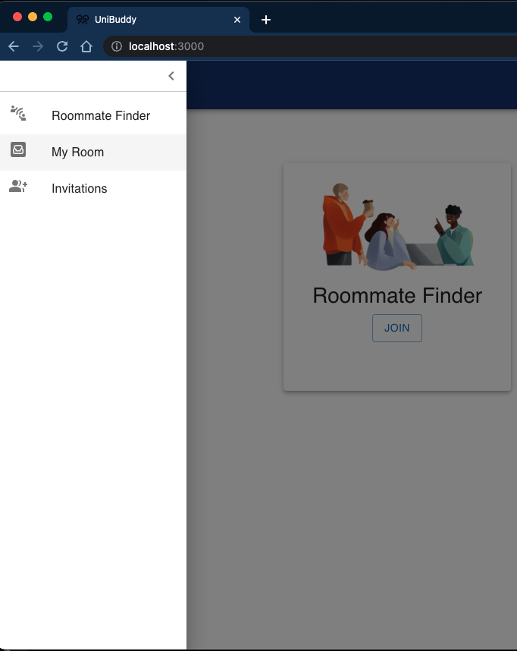
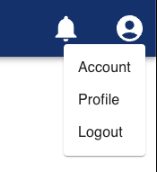

Slide 10
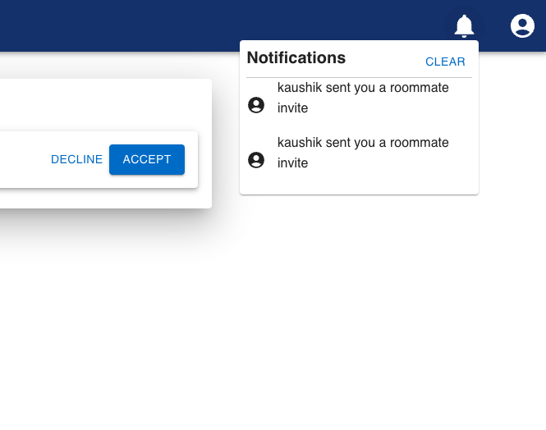

Slide 11
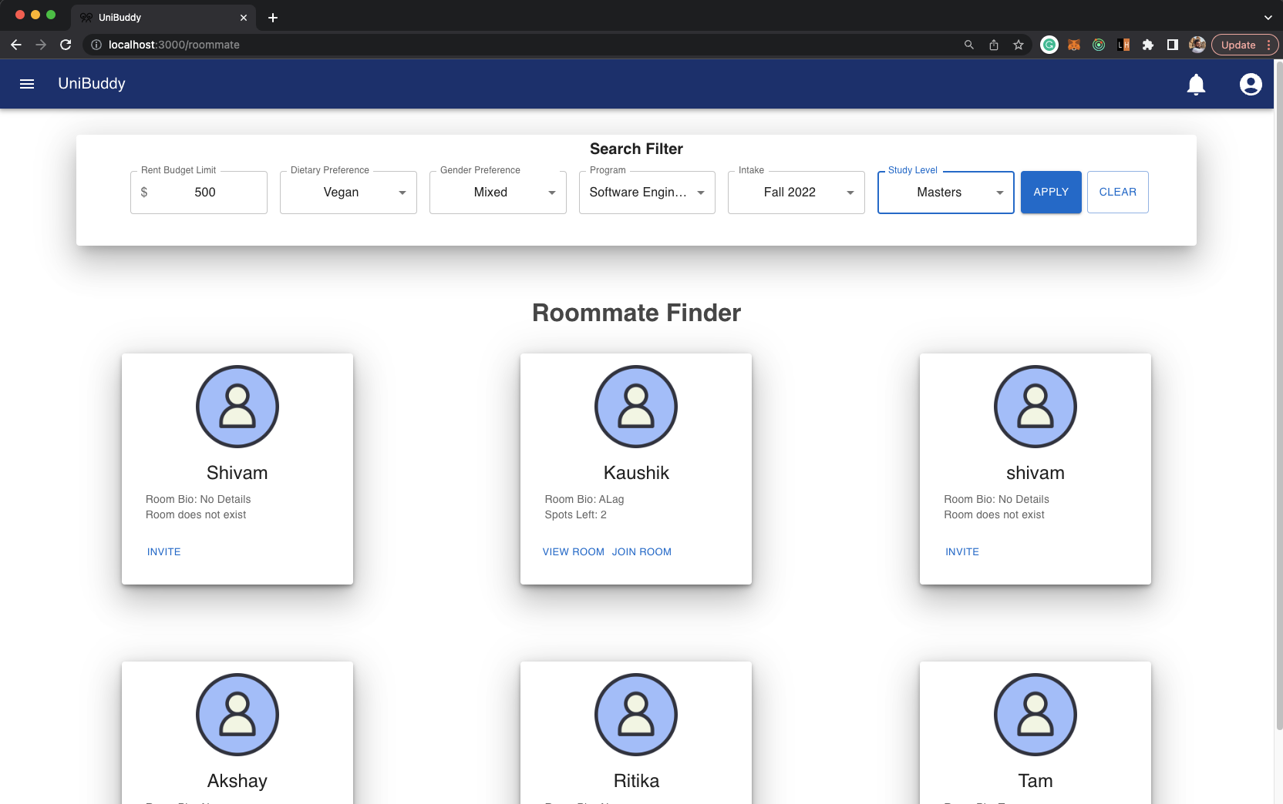

Slide 12
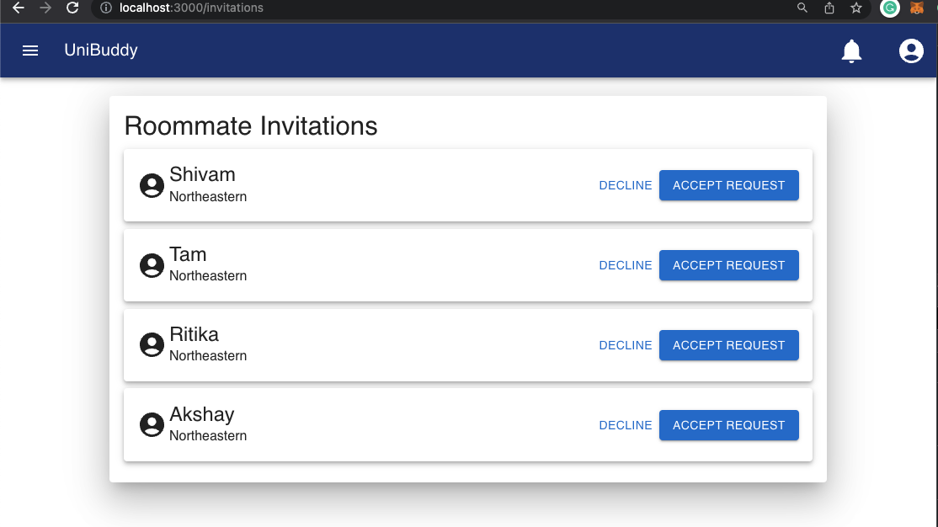

Slide 13
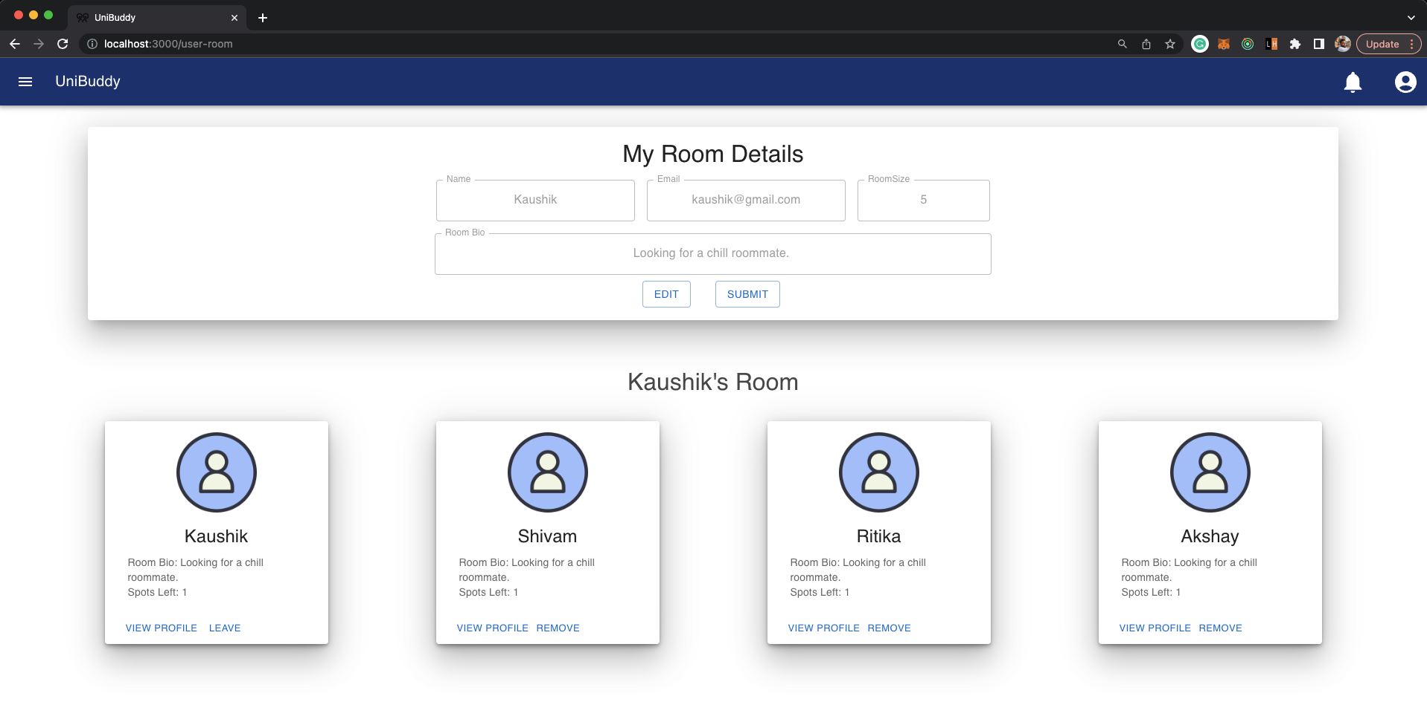

Slide 14
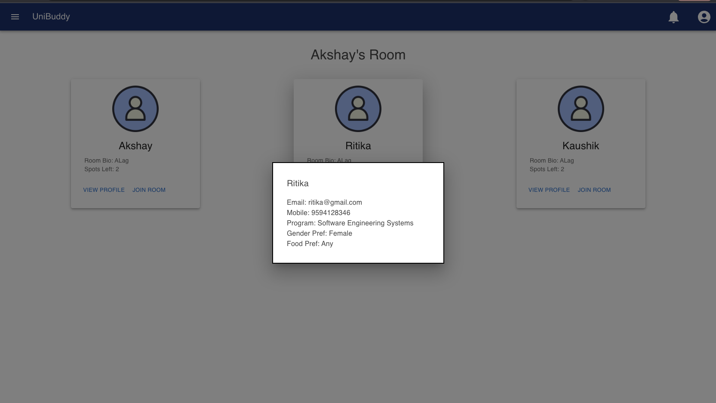

Slide 15
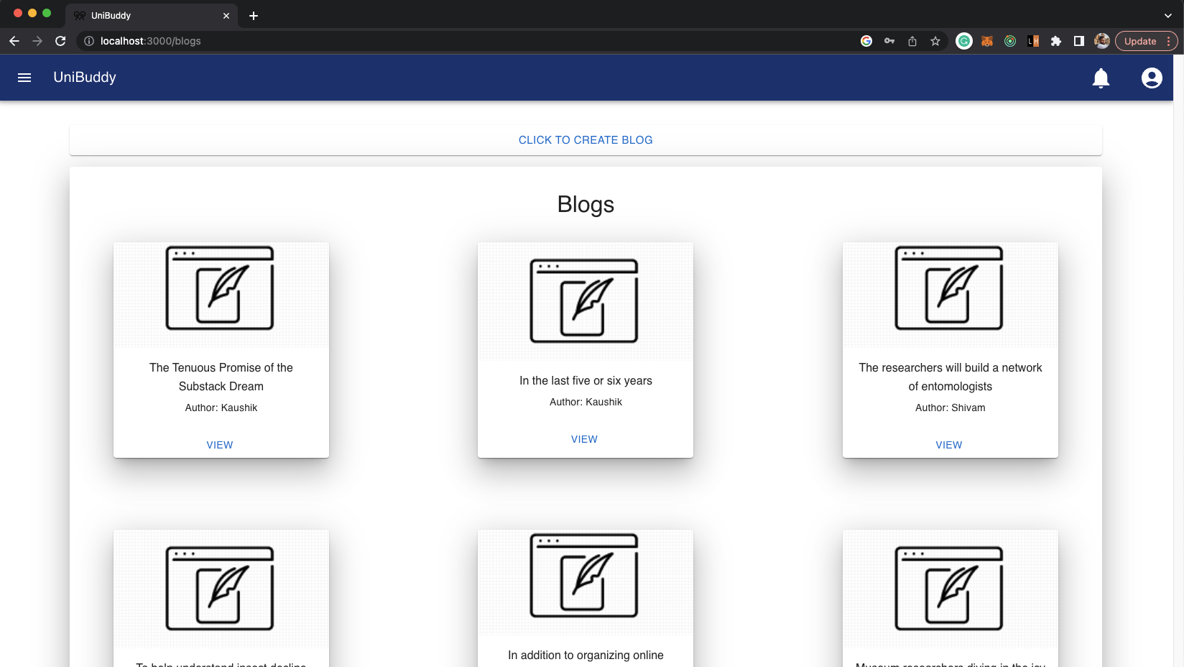

Slide 16
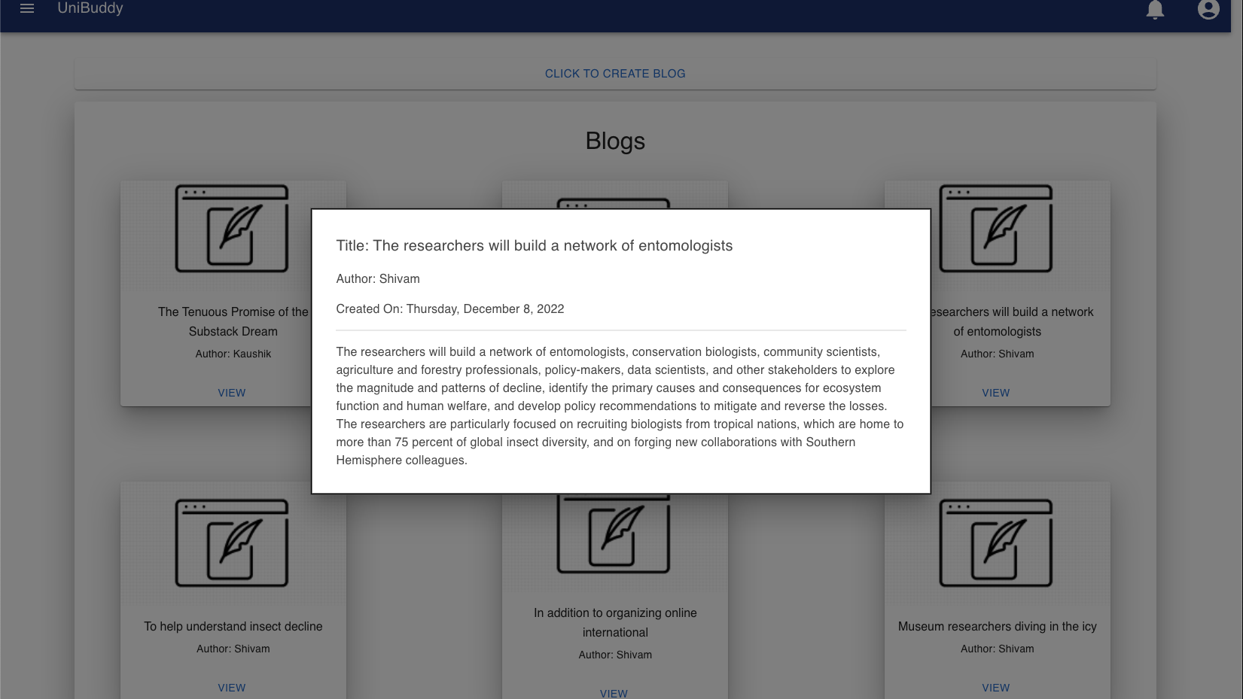

Slide 17
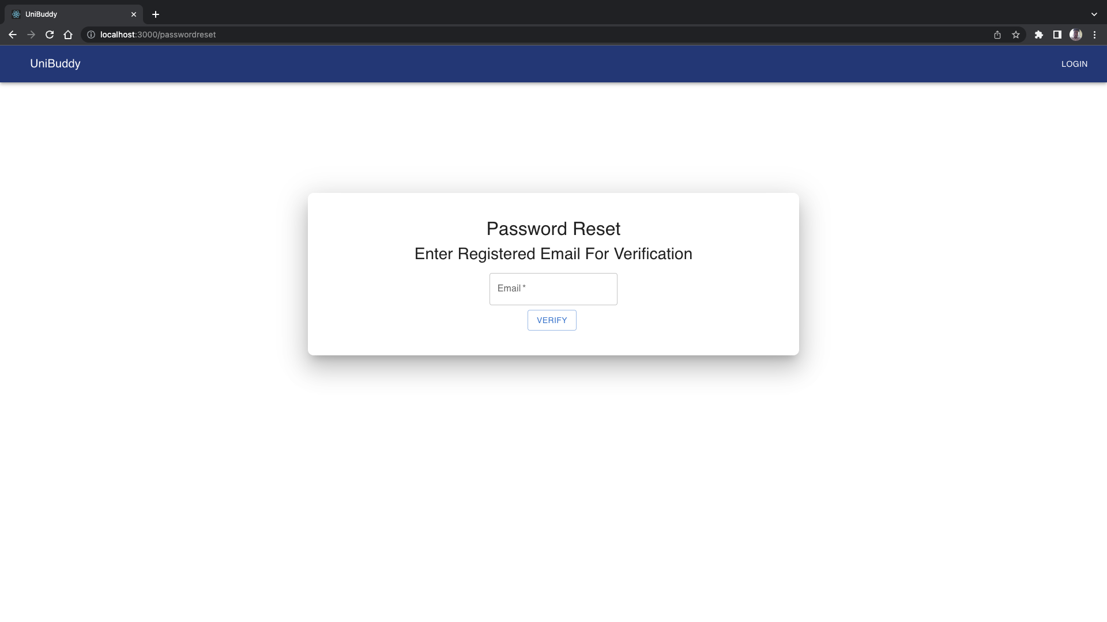

Slide 18
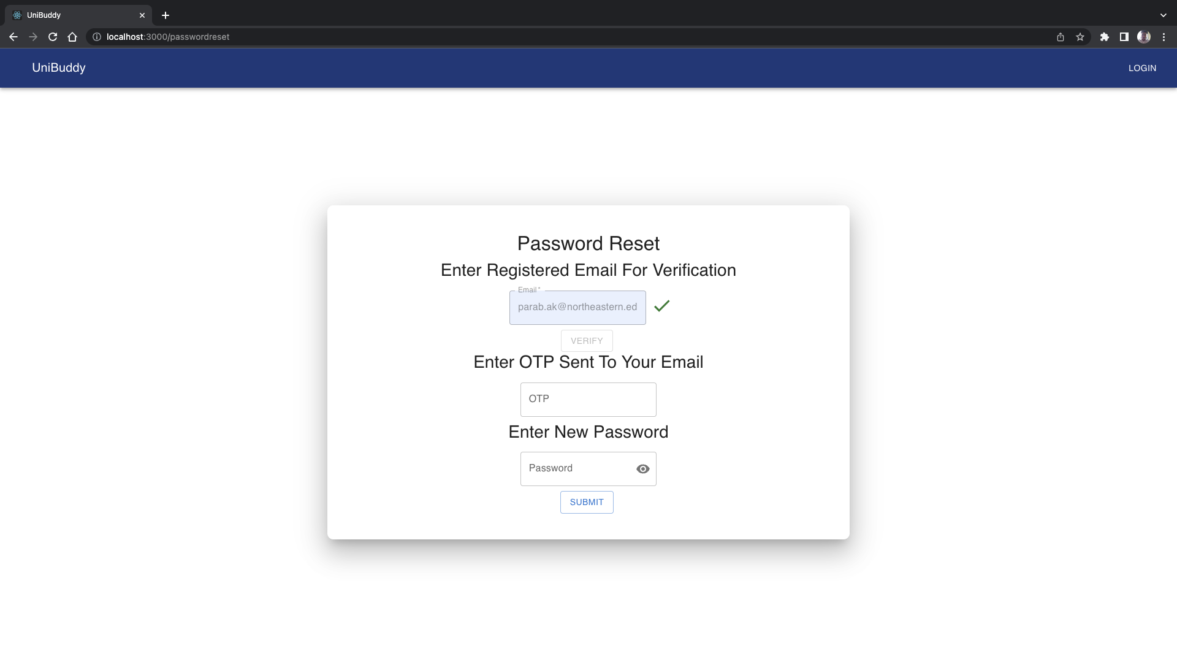

Slide 19
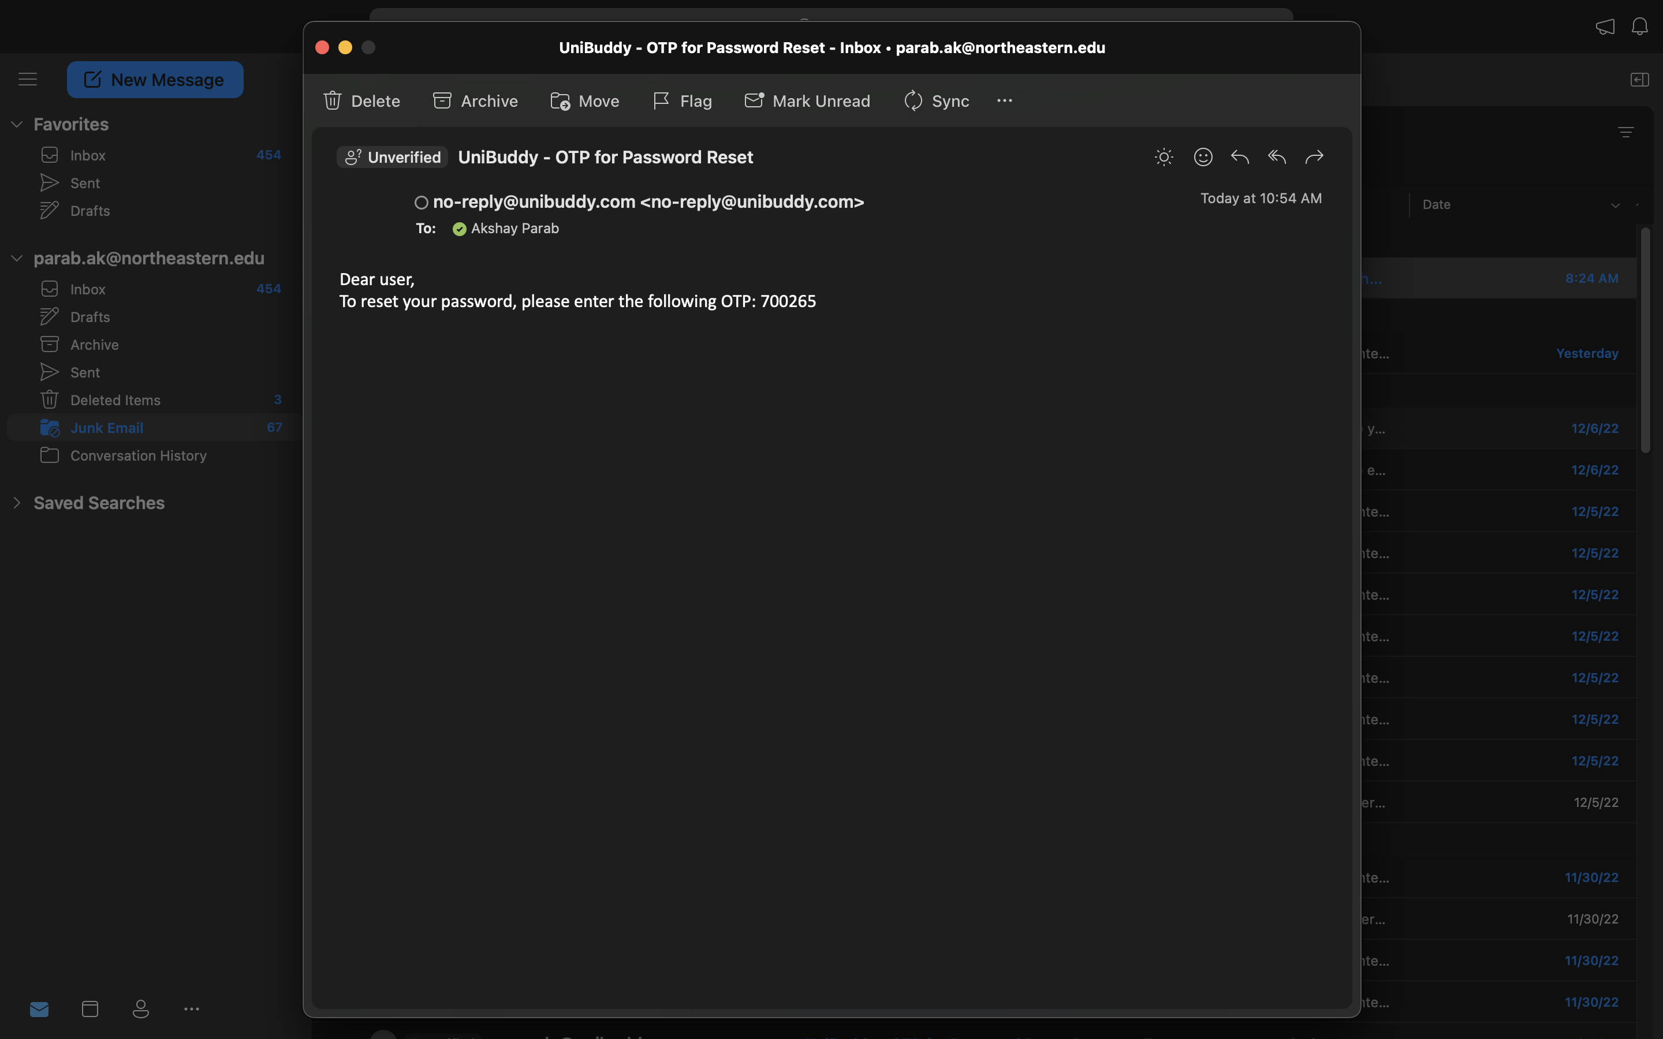

Slide 20


Slide 21
